Slide 1

Sales Prediction Model

Slide 2



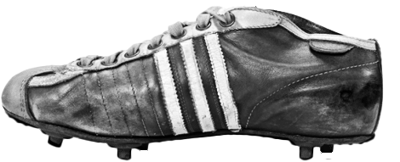

The Challenge: Navigating Sales Forecasting Complexities
Predicting Across Regions & Products
Lack of Revenue Driver Insights
Difficulty forecasting sales for diverse markets and product lines.
Unclear understanding of features that truly influence revenue.
Delays & Inaccuracies
Manual analysis leads to slow and imprecise planning cycles.
A regression model provides data-driven sales predictions for superior decision-making.

Slide 3
Key Capabilities: Empowering Sales Through AI
Predict Total Sales
Identify Key Drivers
Compare Performance
Utilizing Linear Regression for accurate forecasts.
Pinpointing factors like price, units, and margin.
Analyzing sales across regions and product categories.
Support Business Planning
Visualize Sales Patterns
Aids teams in strategic forecasting.
Making insights immediately understandable.

Slide 4
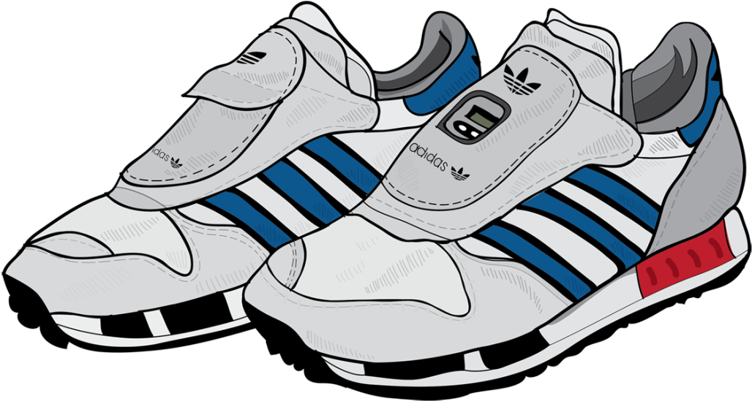

Tools & Technologies: Our Analytical Foundation
Development & Processing
Visualization & Environment
Python
Matplotlib
Model building & comprehensive analysis.
Creating insightful graphical analysis.
Pandas, NumPy
Google Colab
Efficient data preprocessing and manipulation.
Collaborative development & powerful execution environment.
Scikit-learn
Robust Linear Regression model implementation.

Slide 5

Dataset & Features: The Foundation of Our Insights
Dataset sourced from Kaggle, comprising ~10,000 rows and 13 columns of Adidas US retail data.
Key Features Analyzed
Product Type
Region & State
Price per Unit
Units Sold
Operating Profit & Margin
Retailer ID
Target Variable: Total Sales

Slide 6




Methodology: From Raw Data to Predictive Power
Data Preprocessing
Symbols removed, numeric cleaning, date conversions, whitespace trimming, missing target values dropped.
Exploratory Data Analysis
Analyzed sales by region and product, identified top-performing segments.
Model Development
Linear Regression algorithm applied with an 80:20 train-test split for validation.
Model Evaluation
Performance assessed using MAE, MSE, RMSE, and R² Score.

Slide 7

Results: Unveiling Sales Patterns & Performance
Key Findings
High Predictive Accuracy
Model explains ~95% of Total Sales variation (R² ≈ 0.95).
Strong Sales Drivers
Units sold and price significantly impact total revenue.
Top Performing Regions
West and Northeast lead in sales generation.
Best-Selling Products
Men’s Street Footwear and Women’s Apparel drive volume.
Outcome: High prediction accuracy with robust error margins.

Slide 8
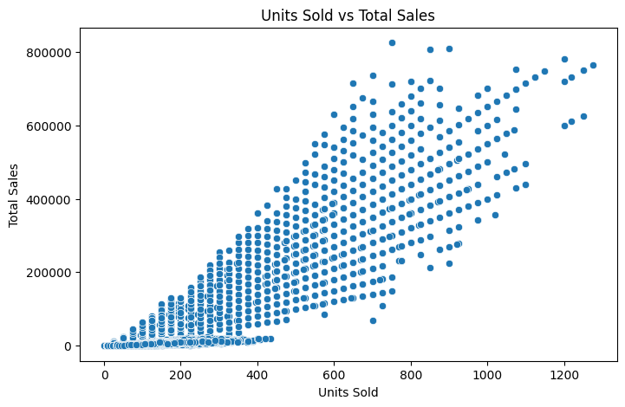
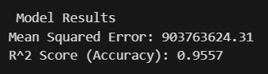

Slide 9
Impact & Business Value: Driving Growth Through Insights
Improved Demand Forecasting
Optimized Supply Chain
Data-Backed Strategy
Enhanced planning reduces waste and improves efficiency.
Informed product and pricing decisions.
Precise predictions for better inventory management.
Clear Revenue Drivers
Stronger Market Targeting
Understanding what truly boosts sales.
Leveraging region and product insights for campaigns.

Slide 10
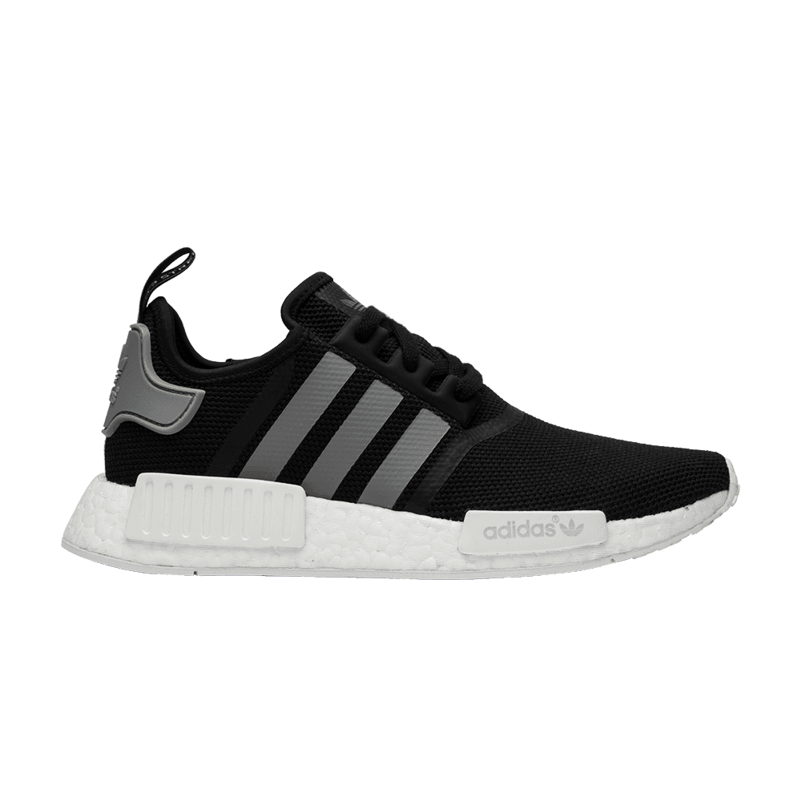




Future Enhancements: Expanding Predictive Capabilities
Explore Advanced Models
Integrate More Features
Test Random Forest, Gradient Boosting for greater accuracy.
Incorporate discount rates, seasonality, and marketing spend.
Deploy Model to Analytics System
Develop Real-Time Dashboard
Seamless integration into existing business intelligence tools.
Visualize sales data and predictions dynamically.

Slide 11

Conclusion: Actionable Insights for Smarter Sales
The Adidas Sales Prediction model transforms raw retail data into powerful, actionable insights.
1
Accurate Predictions
2
Clear Sales Drivers
3
Improved Planning
4
Targeted Strategies
5
Enhanced Revenue
Empowering businesses to improve planning, target the right products and regions, and enhance overall revenue performance.

Slide 12



